Slide 1
IMPACT OF CAR FEATURES
Analysis Price and Probabilities
Shivam Singh

Slide 2
Project Description
This project analyzes the impact of various car features, such as engine power, fuel efficiency, and transmission type, on car price, mileage, and popularity. The goal is to address business questions like how car features affect price, the relationship between engine power and price, and how fuel efficiency varies by cylinder count and transmission type.
This project analyzes the impact of various car features, such as engine power, fuel efficiency, and transmission type, on car price, mileage, and popularity. The goal is to address business questions like how car features affect price, the relationship between engine power and price, and how fuel efficiency varies by cylinder count and transmission type.
Excel Workbook link: https://docs.google.com/spreadsheets/d/10N1nam2GsUx74mrWjcThf2TzMoklyUSV/edit?usp=sharing&ouid=117463697734528382914&rtpof=true&sd=true

Slide 3
Approach
In this project, we used Excel as the primary tool for analysis, leveraging its features like pivot tables to simplify data exploration and summary statistics. Pivot tables allowed us to easily group and compare data, such as average prices by car brand and transmission type, and fuel efficiency by cylinder count. Additionally, we applied descriptive analytics to understand key patterns and relationships in the dataset.
For deeper insights, regression analysis was used to assess the impact of car features (e.g., engine power, transmission type) on price and mileage. These analytical methods were chosen for their simplicity and effectiveness in identifying trends in structured data, allowing us to make informed business decisions.
One challenge was dealing with missing and incorrect data entries, which required thorough cleaning and imputation to ensure accurate analysis. Another limitation was that we didn't implement machine learning models due to the project's scope, but the statistical approach was effective for answering key business questions.

Slide 4
Tech-Stack Used
Microsoft Excel: The project utilized Excel for data analytics, cleaning, and visualization due to its user-friendly interface and powerful tools like pivot tables.
Power Point Presentation: PowerPoint (PPT) was used to present the report in a structured format.
ApowerREC: ApowerREC was employed for video presentations, ensuring a clear and engaging delivery.
Excel Workbook link: https://docs.google.com/spreadsheets/d/10N1nam2GsUx74mrWjcThf2TzMoklyUSV/edit?usp=sharing&ouid=117463697734528382914&rtpof=true&sd=true

Slide 5
Tasks: Analysis
Task 1: Popularity and Model by Category
Task 2: Relationship between a car's engine power and its price
Task 3: Regression analysis on variables
Task 4: Variation in Average Car Price Across Different Manufacturers.
Task 5: Fuel efficiency VS The number of cylinders in a car's engine

Slide 6
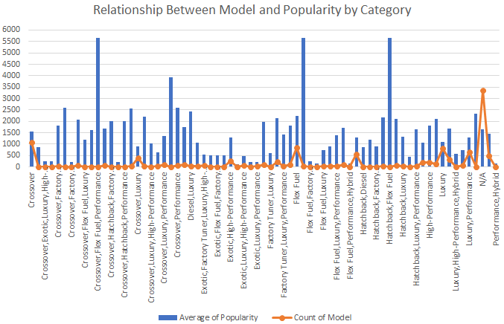
Popularity and Model by Category
By popularity, Specific categories include hatchback with flex fuel, flex fuel with diesel, crossover with flex fuel performance, and crossover luxury performance hybrid. the most common vehicle types are crossover with 1,069 models, flex fuel with 855 models, and luxury with 815 models, while 3,365 models are classified as N/A or unknown.

Slide 7
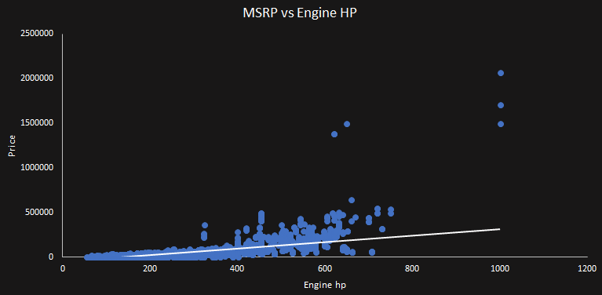
Car Engine Power vs Price(MSRP)
In the relationship between car engine power and price, the trendline shows an upward trend, indicating that as engine horsepower increases, the price also tends to rise. Notably, cars like the Bugatti Veyron, which have the highest horsepower 1001, also come with significantly very higher prices.

Slide 8
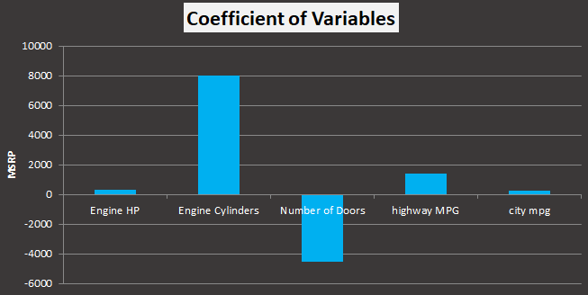
Regression Analysis on Variables
In the regression analysis on various variables such as engine horsepower, engine cylinders, number of doors, highway MPG, and city MPG, the engine cylinders showed the highest coefficient, indicating the strongest effect on price. This suggests that the number of cylinders significantly impacts car pricing. Highway MPG also has a slight positive effect on price, while the number of doors showed a negative coefficient, indicating that it does not correlate positively with price.

Slide 9
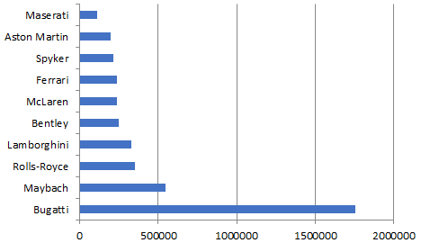
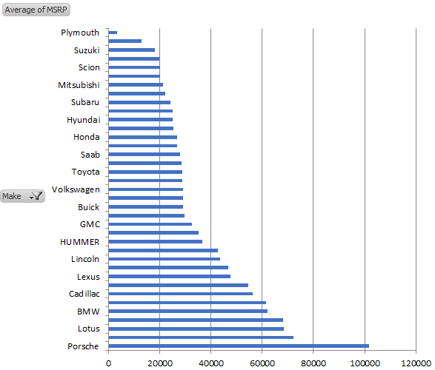
Variation in Avg Price across
Different Manufacture
These are the top 10 list of highest average price by car manufacture.
Bugatti stands out with an average price of around $1,500,000, while the other nine manufacturers, such as Maybach, Rolls-Royce, and Lamborghini, have average prices ranging from $500,000 to $100,000. In contrast, the majority of car manufacturers typically have average prices in the range of $40,000 to $20,000.

Slide 10
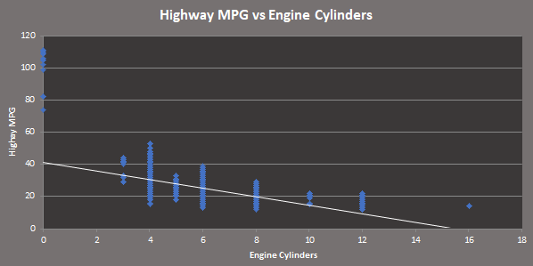
Impact of Cylinder Count on Fuel Efficiency
The impact of cylinder count on fuel efficiency, as seen in the charts, shows a decline. As the number of cylinders increases, fuel efficiency decreases. Electric cars, which have 0 cylinders, achieve around 100 MPG. Cars with 3 cylinders typically have around 40 MPG. The majority of cars have 4 cylinders, with fuel efficiency ranging between 50 and 20 MPG. There is a slight decrease to around 40 to 10 MPG for cars with 5-6 cylinders. Similarly, as the cylinder count increases, the MPG continues to decline, with cars having 10 or more cylinders dropping below 20 MPG.

Slide 11
DASHBOARD TASK
Task 1: Variation of Car Prices by Brand and Body Style
Task 2: Average Car Prices by Brand and Variation by Vehicle Style
Task 3: Impact of Transmission Type on MSRP Across Different Vehicle Styles
Task 4: Fuel Efficiency Variation Across Body Styles and Model Years
Task 5: Variation of Horsepower, MPG, and Price Across Car Brands

Slide 12
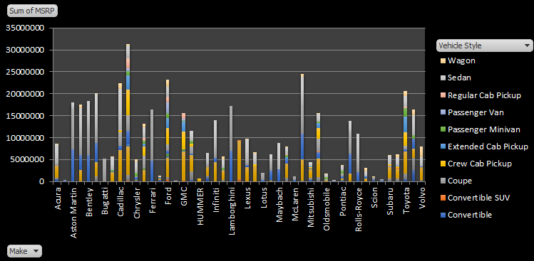
Variation of Car Prices by Brand and Body Style
In the analysis of car price variation by brand and body style, Chevrolet and Mitsubishi have the highest total prices across all models. Among vehicle styles, sedan, 4-door, and coupe have the highest total sum of prices. Additionally, Ferrari coupes and Lamborghini coupes hold the highest sum of MSRP among luxury sports cars.

Slide 13
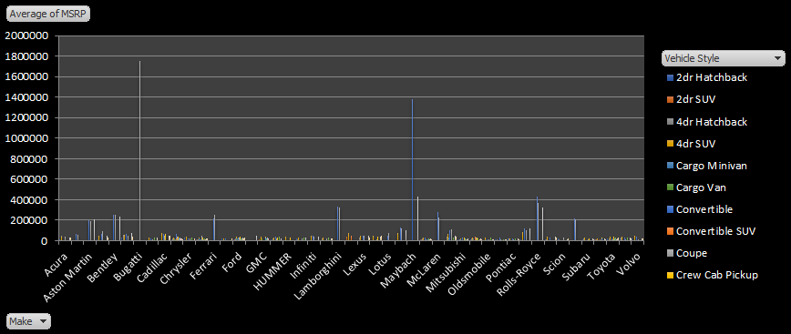
Average Car Prices by Brand and Variation by Vehicle Style
In the analysis of average car price by brand and vehicle style, Bugatti and Maybach have the highest average prices at $1,800,000 and $1,400,000, respectively. Other top brands average around $200,000, while major car brands average around $50,000. The lowest average price is found in the Plymouth brand. In terms of vehicle styles, convertibles and coupes have the highest average prices, with Bugatti coupes having the highest, followed by Maybach convertibles in second place.

Slide 14
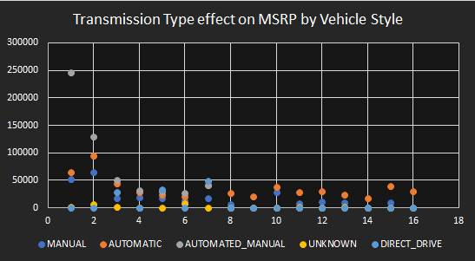
Impact of Transmission Type on MSRP Across Different Vehicle Styles
The analysis of the impact of transmission type on MSRP across different vehicle types shows that automated manual and automatic transmissions tend to have higher prices. Among vehicle types, coupes and convertibles also command higher prices. Specifically, coupes with automated manual transmissions have an average price of $245,000, while convertibles with automated manual transmissions have an average price of $129,000. On the other hand, vehicles with manual transmissions tend to have a lower average MSRP compared to their automatic counterparts.

Slide 15
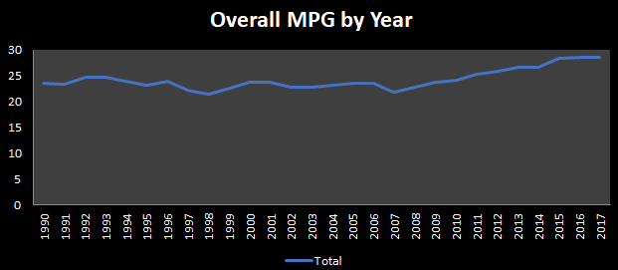
Fuel Efficiency Variation Across Body Styles and Model Years
In analyzing fuel efficiency, the overall MPG for each variation across all vehicle styles shows slight deviations by year. However, there is a noticeable upward trend within the range of 25 to 30 MPG, which consistently appears each year. This indicates that, while there are fluctuations, the fuel efficiency of vehicles has been gradually improving, with this specific range being the most significant for annual MPG performance.

Slide 16
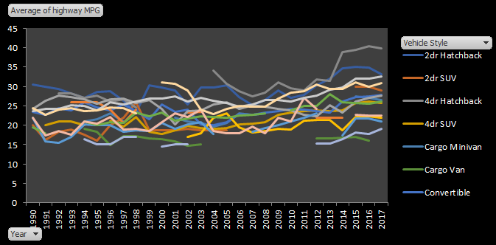
In this chart, we can observe the MPG trends for each vehicle style displayed through a line chart. Some vehicle styles show breaks in the lines, indicating that these styles were introduced or manufactured in certain years. The 4-door hatchback consistently has a high average MPG, peaking around 40 MPG, particularly from 2003 onwards and reaching its highest in the last four years. The 2-door hatchback follows, showing fluctuations over time but an overall upward trend. Similarly, the sedan shows very little deviation, maintaining a steady upward trend in fuel efficiency. In contrast, passenger vans and cargo vans exhibit significantly lower MPG.

Slide 17
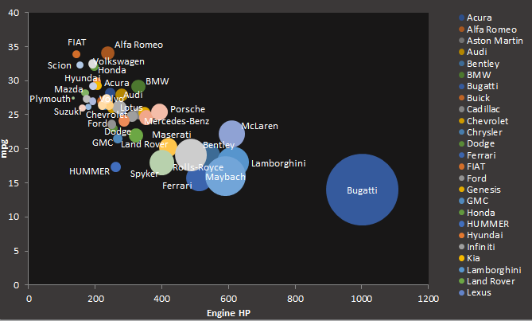
Variation of Horsepower, MPG, and Price Across Car Brands
In this bubble chart, where engine horsepower is on the horizontal axis, MPG on the vertical axis, and price represented by bubble size, we can observe several key trends. Bugatti stands out with a high price, over 1,000 horsepower, and low mileage. Other top brands typically show 15-20 MPG, with 400-600 horsepower and similarly high prices. The majority of vehicles fall within the range of 150-300 horsepower, achieving 20-30 MPG, and are priced much lower in comparison to high-end brands

Slide 18
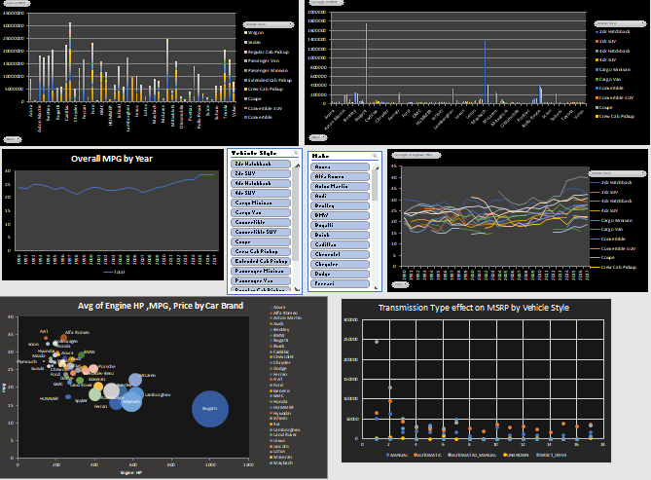
Dashboard

Slide 19
Results
In this project, we began by cleaning and preprocessing the dataset, which involved removing duplicates, filling in missing values, and correcting data errors to ensure accuracy. After this, we proceeded with an in-depth analysis of car features and their impact on price, mileage, and engine power.
The results revealed several key insights. For instance, there is a strong correlation between engine horsepower and price, where high-end brands like Bugatti and Lamborghini dominate with both the highest horsepower and prices. Additionally, transmission type and vehicle style significantly influence MSRP, with automated manual transmissions in coupes and convertibles being the most expensive. We also observed that fuel efficiency decreases as the number of cylinders increases, while electric vehicles, with 0 cylinders, have the highest MPG.
While the analysis provided valuable insights, some limitations, such as gaps in data for specific vehicle styles and years, affected the consistency of results. Future analyses could focus on electric vehicles, machine learning-based price predictions, and expanding the dataset for a more comprehensive study.

Slide 20
Thank you

